Slide 1
Graduate School
Manual for Academic Affairs (Student)

Slide 2
목 차
System Login
Menu
Application for Comprehensive Exam
Application for Advisor
Application for Leave of Absence/Return
Evaluation of Thesis(Master & Doctor)
Application for course of study acceleration
Application to withdraw

Slide 3
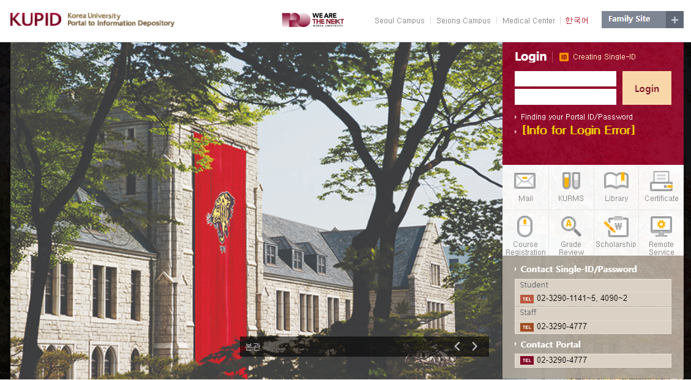
1. System Login : http://portal.korea.ac.kr
3
1
2
Enter ID: Fill in the portal ID.
Enter password: Fill in the portal password.
Log in: Fill in your ID and password and log in.

Slide 4
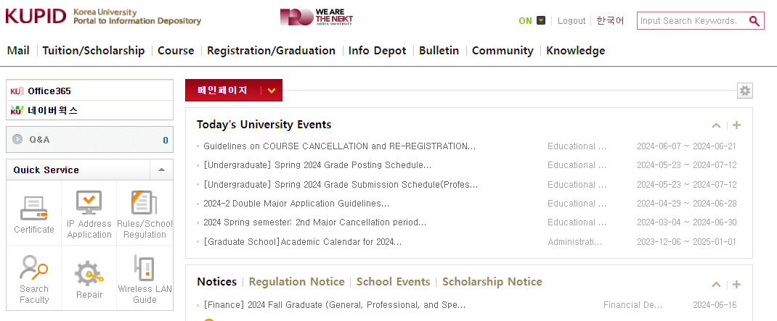
2. Menu
1
Menu: Check the configuration of the user menu list and click on the desired menu to access the corresponding screen.

Slide 5
Application for Comprehensive Exam

Slide 6
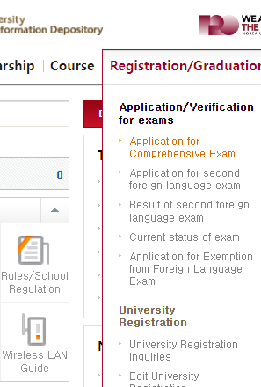
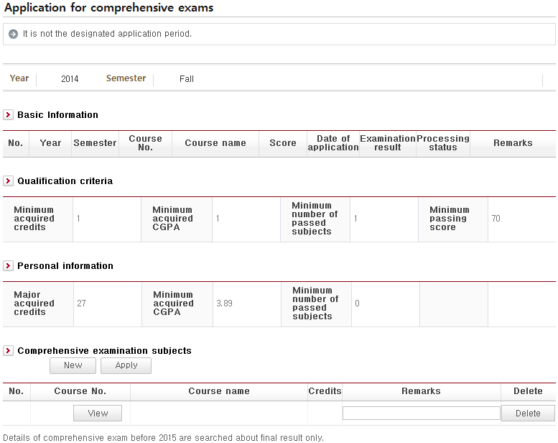
4.3 Application for Comprehensive Exam
1
4
2
3
- This page is where you apply for the comprehensive exam.
New: Clicking this button creates a row. Click the "View" button to choose the subject you are applying for.
View: Click this button to view the subjects available during the year before this application period.
Delete: Click this button to delete a newly created row. This button will remain active until your application is complete.
Apply: This button can be activated only when the required qualifications and personal information are checked and fulfilled. You can apply for minimum of one subject and maximum of five.

Slide 7
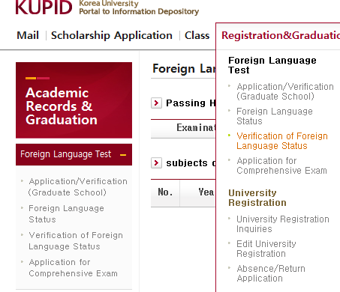
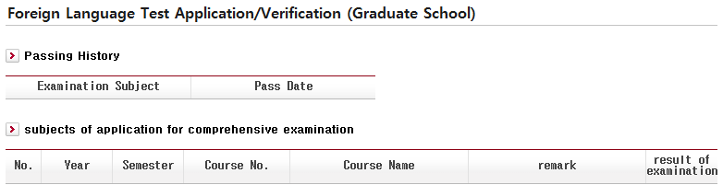
4.4 Foreign Language Test Application/Verification (Graduate School)
- This page shows the dates of application/results of foreign language tests and comprehensive examinations.

Slide 8
Application for Advisor

Slide 9
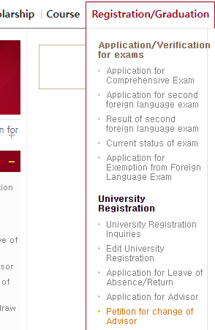
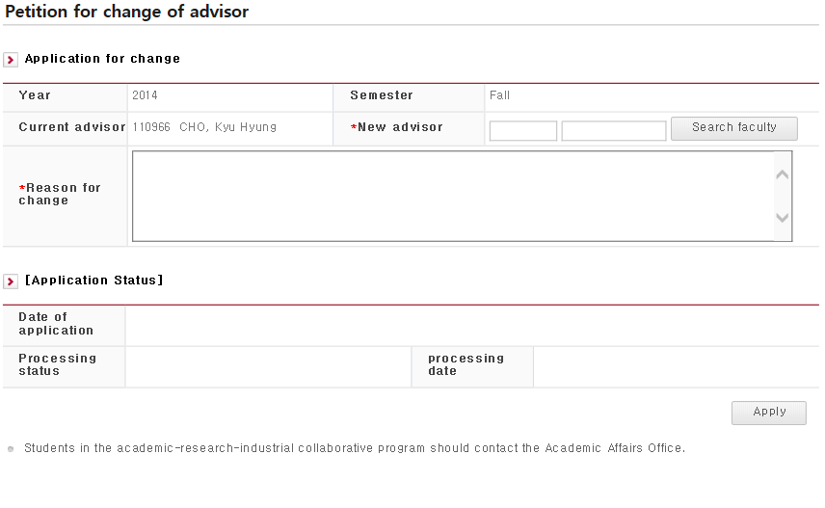
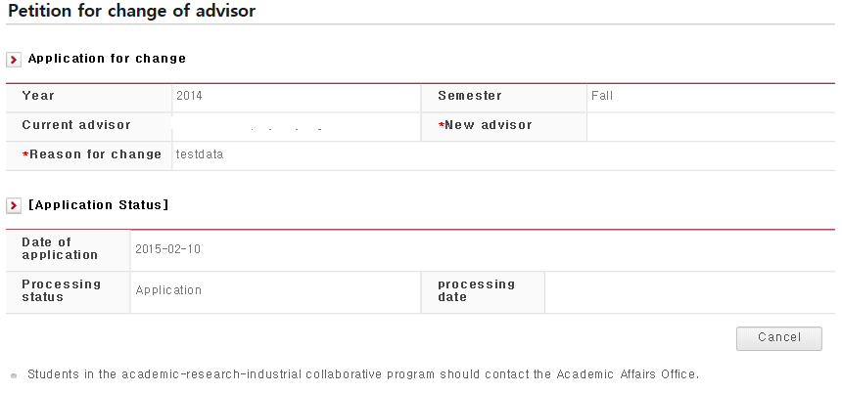
1.1 Petition for Change of Advisor
1
2
3
5
4
Use the pop-up window to search for and choose the advisor you want to change to.
Enter reason(s) for application.
Click the [Apply] button.
Application can be canceled (unless your advisor has already approved it)
Tab location

Slide 10
Application for Leave of Absence/Return

Slide 11
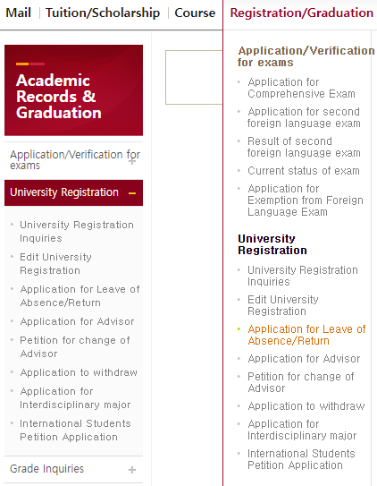
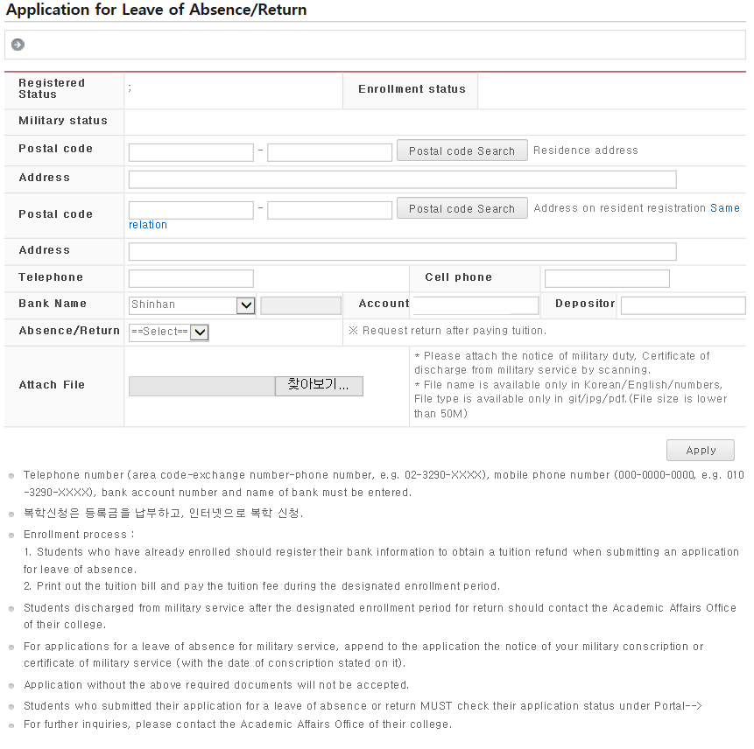
5.1 Application for Leave of Absence/Return
1
2
3
5
4
7
7
6
- You can apply for a leave of absence or return.
Enter the information required for application.
The information in your school registry will be automatically entered into this field.
If [Same] is clicked, the address in your school register will be automatically entered into this field.
The bank information in your school register will appear. Enter the information of the bank account into which you wish your tuition fee to be refunded.
Enter the period of and reason for the absence.
Apply.
Tab location

Slide 12
Evaluation of Thesis(Master & Doctor)

Slide 13
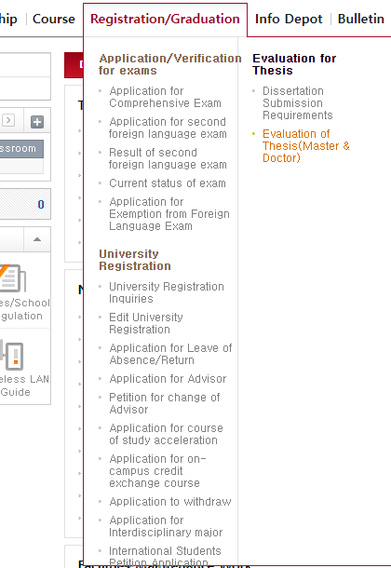
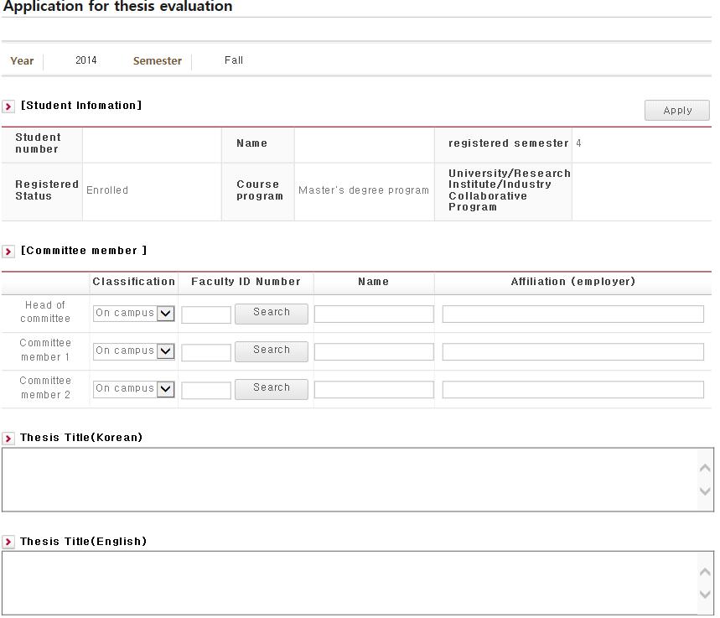
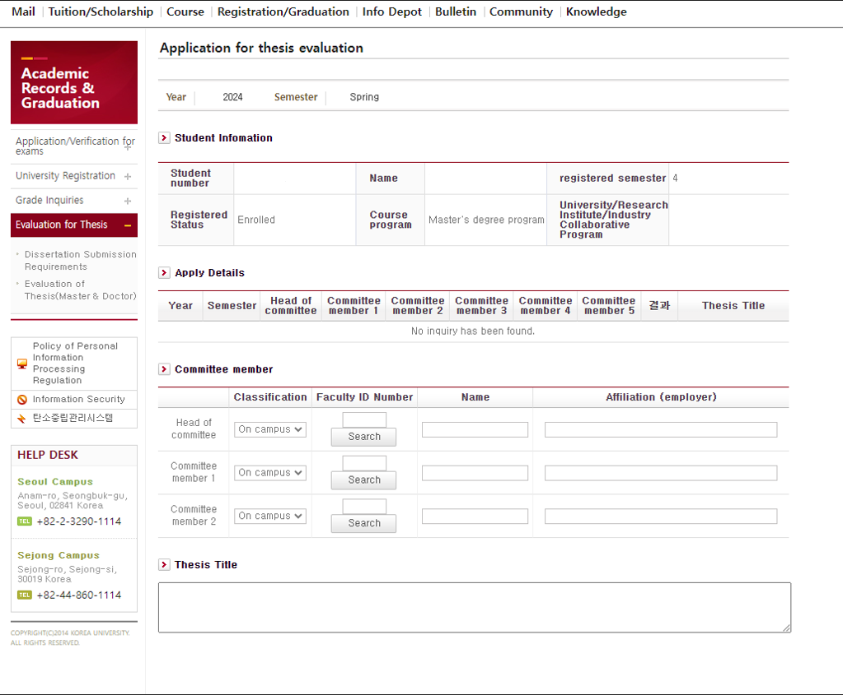
5.1 Evaluation of Thesis(Master & Doctor)
1
2
- You can apply to have your thesis evaluated.
Apply: You can choose your committee members from the pop-up window before applying.

Slide 14
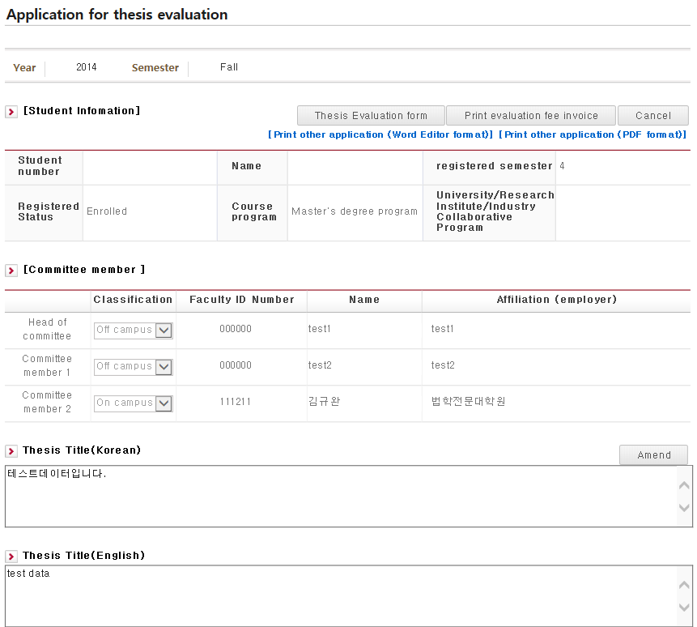
5.1 Evaluation of Thesis(Master & Doctor)
5
6
3
7
4
- You can apply to have your thesis evaluated.
Cancel: You can cancel your application if its processing status is "Applied".
수정 : 신청기간 내에서 논문 제목에 한하여 수정이 가능하다.
청구논문심사 신청서 출력이 가능하다.
심사료 고지서(영수증)를 출력 할 수 있다.
신청에 필요한 기타출력물(DPF,HWP)를 출력 할 수 있다.

Slide 15
Application for course of study acceleration

Slide 16
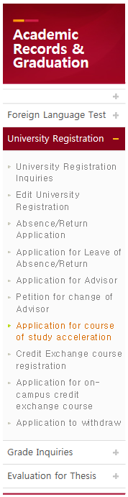
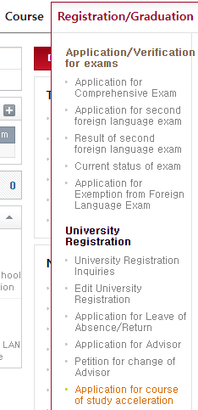
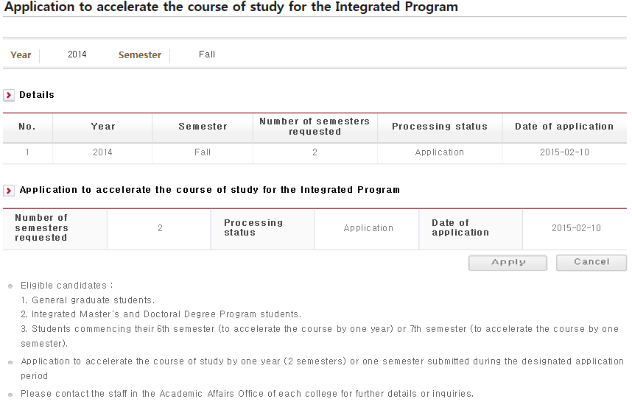
9.1 Application for course of study acceleration
2
3
4
1
- Graduate school students may apply for course of study acceleration for one semester or two (one academic year) or cancel the application within the designated period.
- Outside the designated period, students can only view the information.
- Even during the designated application period, students cannot reapply or cancel their application if their application status is "Accepted", "Processing" or "Canceled"
You can view notices affecting you as well as other relevant information.
The semester relevant to the application is automatically entered. (For example, for applicants in their 6th semester, "2" will be entered and for those in their 7th semester, "1" will be entered.
Apply: Click [Apply]. This will only be applicable to the semester for which an application has not been previously submitted or status indicated as "canceled".
Cancel: This only applies to the semester whose processing status is "Applied".

Slide 17
Application to withdraw

Slide 18
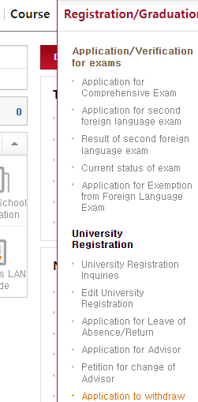
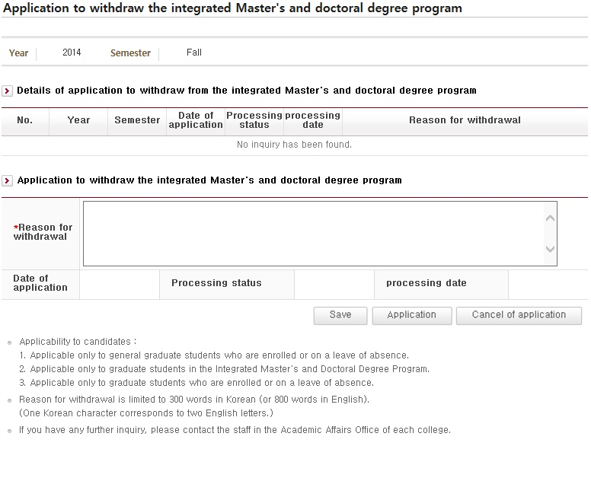
9.1 Application to withdraw
2
3
4
5
1
- Students in the Integrated Master's & Doctoral Program can withdraw from the program or cancel their withdrawal for the relevant semester or year.
- If the application for withdrawal is declined, another application can be submitted the following semester.
- If the current status is "Accepted," "Approved" or "Canceled ," no application withdrawal or cancellation will be accepted.
You can view notices regarding the affected persons and other relevant information.
Before saving, enter reason(s) for withdrawal (up to 300 letters)
Save: You can enter/amend reasons for withdrawal.
Apply: Application is complete only when [Apply] is clicked.
Cancel: You can cancel a saved application or whose status is "Applied."

